Slide 1
Aviation Data Analysis
Aircraft Recommendations Depending For Business Flights

Slide 2
Summary
The goal of this project is to give recommendations to the new Aviation Division on the best aircraft to purchase for business and private enterprise ventures.
Our findings revealed that some aircrafts were indeed safer than others given certain considerations.

Slide 3
OUTLINE
Business Problem
Data
Method
Results
Conclusions

Slide 4
Business Problem
The company has ventured into the aviation business. Particularly, operating airplanes for commercial and private enterprise.
The challenge is that the company has no prior knowledge of potential risks associated with the aircrafts.
The aim is to determine which aircraft bears the least risk to the company as it starts this new business venture.

Slide 5
Data
The data of use will be the cleaned version of the aviation dataset by the NTSB.
The data consists of the following relevant features; the aircraft make and model, total fatal injuries, total uninjured people, the purpose of the flight, the accident location, the number of engines of involved aircraft and the engine type.

Slide 6
Methods
A number of methods were used to clean, analyze and visualize the data.
Pandas library was used to clean and analyze the data.
Some visualizations were also made with the aid of matplotlib.pyplot and seaborn.

Slide 7
Results
From the analysis, a number of visualizations were generated.
A cleaned aviation data file was also created for subsequent use.

Slide 8
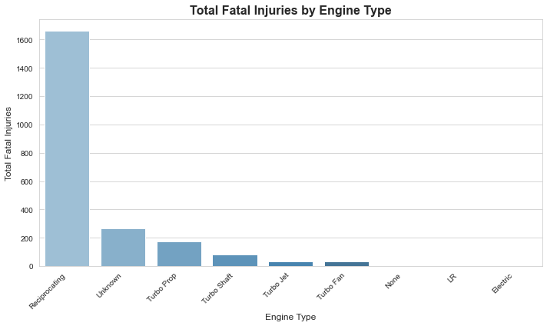
Total Fatal Injuries against engine type
We can clearly observe that aircraft which use reciprocating engine type are involved in the most accidents while those that use turbo fan, LR and electric are safer.

Slide 9
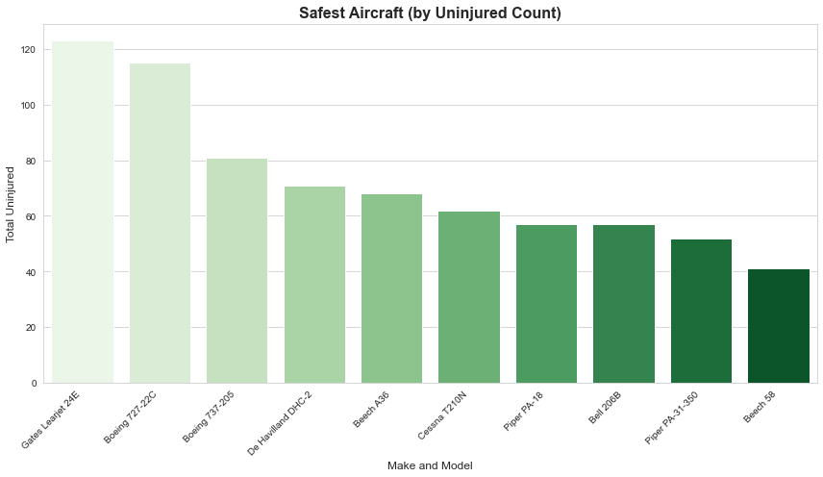
Number of uninjured passengers against aircraft model within make
In the visualization, we can clearly see that the Gates Learjet,24E is the safest option for business purposes.

Slide 10
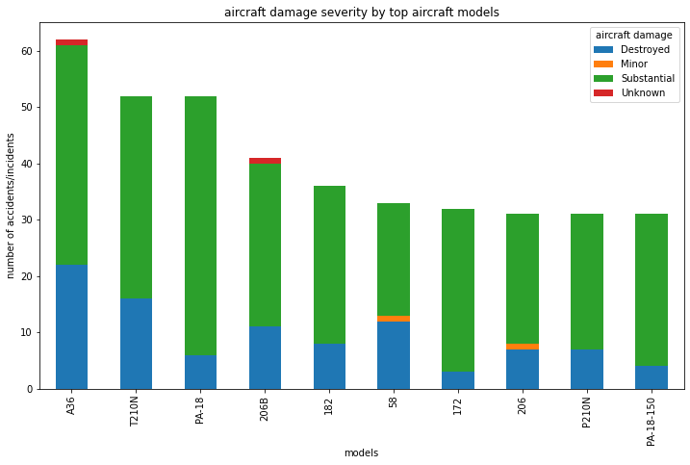
Aircraft damage for different models
The least robust model is the A36 model

Slide 11
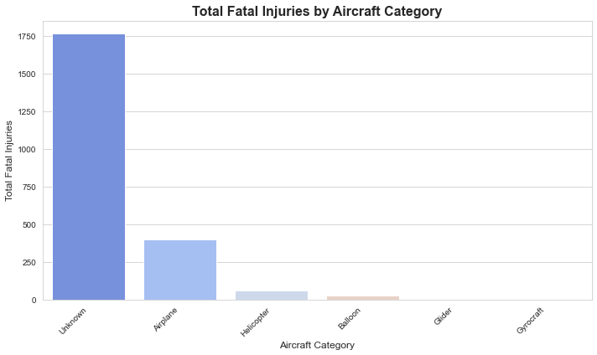
Aircraft category against total fatal injuries
Helicopters are seen to be among those associated with the least total fatal injuries.

Slide 12
Conclusions
Aircraft with electric, LR and even Turbo fan engine types are recommended since they have the least total fatal injuries.
The company should purchase the Gates Learjet,24E, which is the safest option for business purposes since it has the highest rates of uninjured users.
Helicopters are illustrated to be among the categories associated with the least total fatal injuries and is strongly recommended for business purposes.
For future projects, the make and models could be grouped together to further narrow down on specific aircraft characteristics.

Slide 13
THANK YOU!!!!!
Email: shemrodgers@gmail.com
GitHub: @OmondiOmolo/@Shem Omondi
LinkedIn: shem rodgers

